Slide 1
Capstone Engagement
Assessment, Analysis, and Hardening of a Vulnerable System

Slide 2
Table of Contents
This document contains the following sections:
01
Network Topology
02
Red Team: Security Assessment
03
Blue Team: Log Analysis and Attack Characterization
Hardening: Proposed Alarms and Mitigation Strategies
04

Slide 3
Network Topology
‹#›

Slide 4
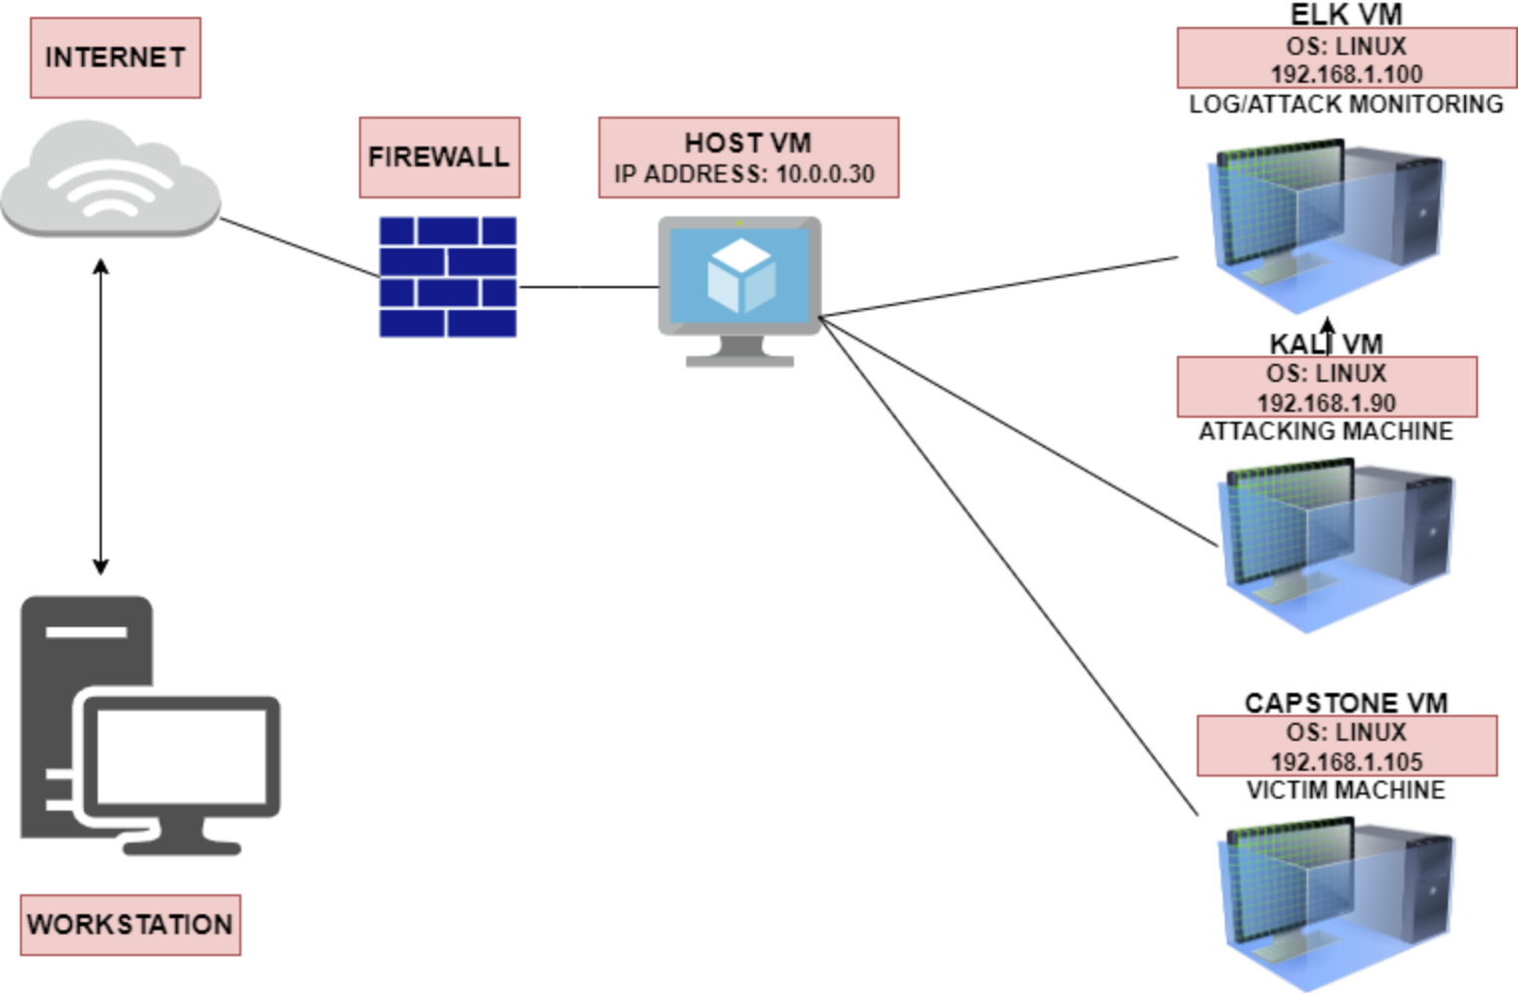
Network Topology
Network
Address Range:
Netmask:255.255.255.0
Gateway:10.0.0.1
Machines
IPv4:192.168.1.100
OS: Linux
Hostname: ELK
IPv4: 192.168.1.90
OS: Linux
Hostname: KALI
IPv4: 192.168.1.105
OS::Linux
Hostname:CAPSTONE
IPv4:10.0.0.30
OS:Windows
Hostname:
ML-RefVm-684427
Notes:
WORKSTATIONWORK

Slide 5

Red Team
Security Assessment
‹#›

Slide 6
Recon: Describing the Target
Nmap identified the following hosts on the network:
Hostname | IP Address | Role on Network
ML-RefVm-684427 | 10.0.0.30 | This is the main machine that hosts the three VMs :Kali, Capstone and ELK
CAPSTONE | 192.168.1.105 | This is the victim machine that is being attacked by the Kali VM
KALI | 192.168.1.90 | This is the attacking machine that is attacking the Capstone VM
ELK | 192.168.1.100 | This server collects all the attack info and keeps logs of all the activities being performed

Slide 7
Vulnerability Assessment
The assessment uncovered the following critical vulnerabilities in the target:
Vulnerability | Description | Impact
OPEN PORT 80 (HTTP) | Port 80 is the port that sends and receives web based communication and messages from the web server. | Leaving this port open allows public access to the web server and and to folders and sensitive data on company website.
BRUTE FORCE VULNERABILITY | A brute force is a hacking method that uses trial and error to crack passwords, login credentials and encryption. | This allows attackers to identify the correct login credentials to secure websites, files or folders.
BACKDOOR VULNERABILITY | The backdoor is a hidden entrance to a computer system that can be used to bypass security policies | This allows attackers to have full remote access to computer system. This also allows them to gain continuous access to a system and monitor all changes.
SENSITIVE DATA EXPOSURE | This is exposing sensitive data that can be used by attackers to exploit a computer system. | This allows attackers to exploit a system using the sensitive data information that was found.

Slide 8
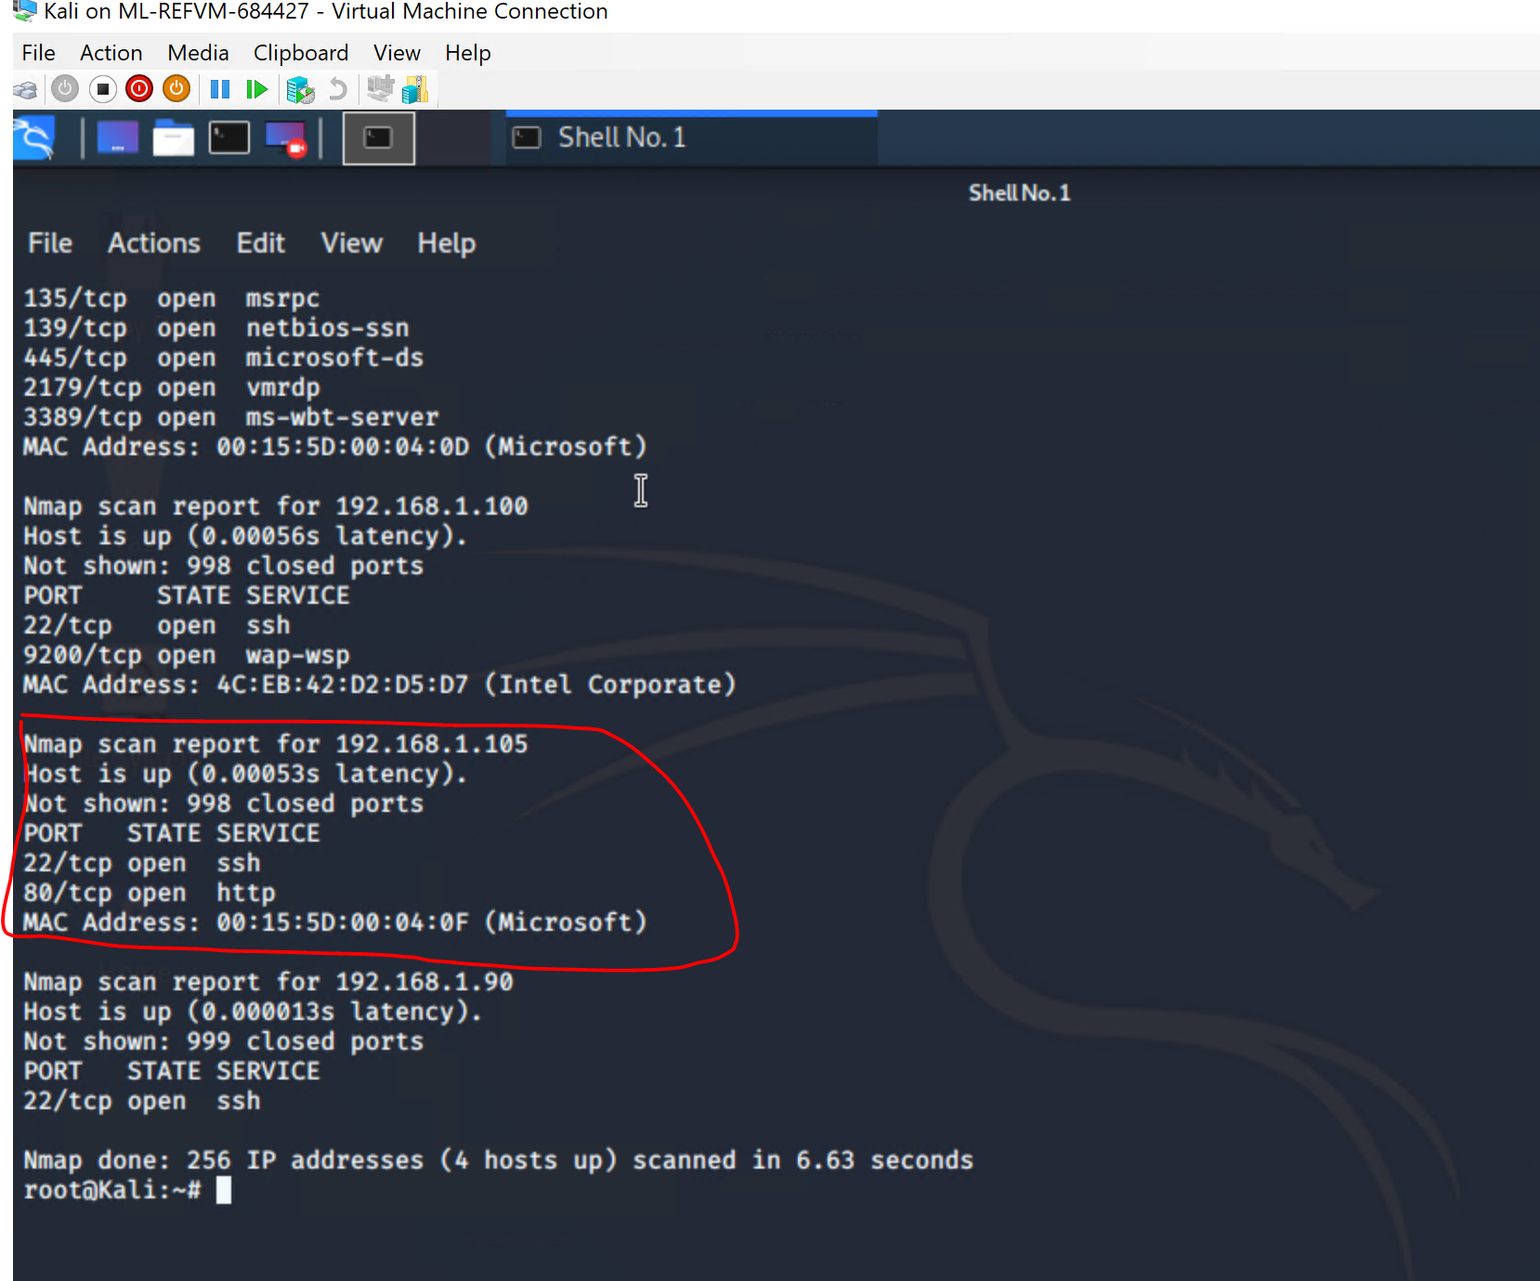
Exploitation: OPEN PORT 80 (HTTP)
01
02
03
Tools & Processes
NMAP was used to scan the open ports on the victim machine
Achievements
I found out that ports 80(HTTP) and 22(ssh) were open

Slide 9
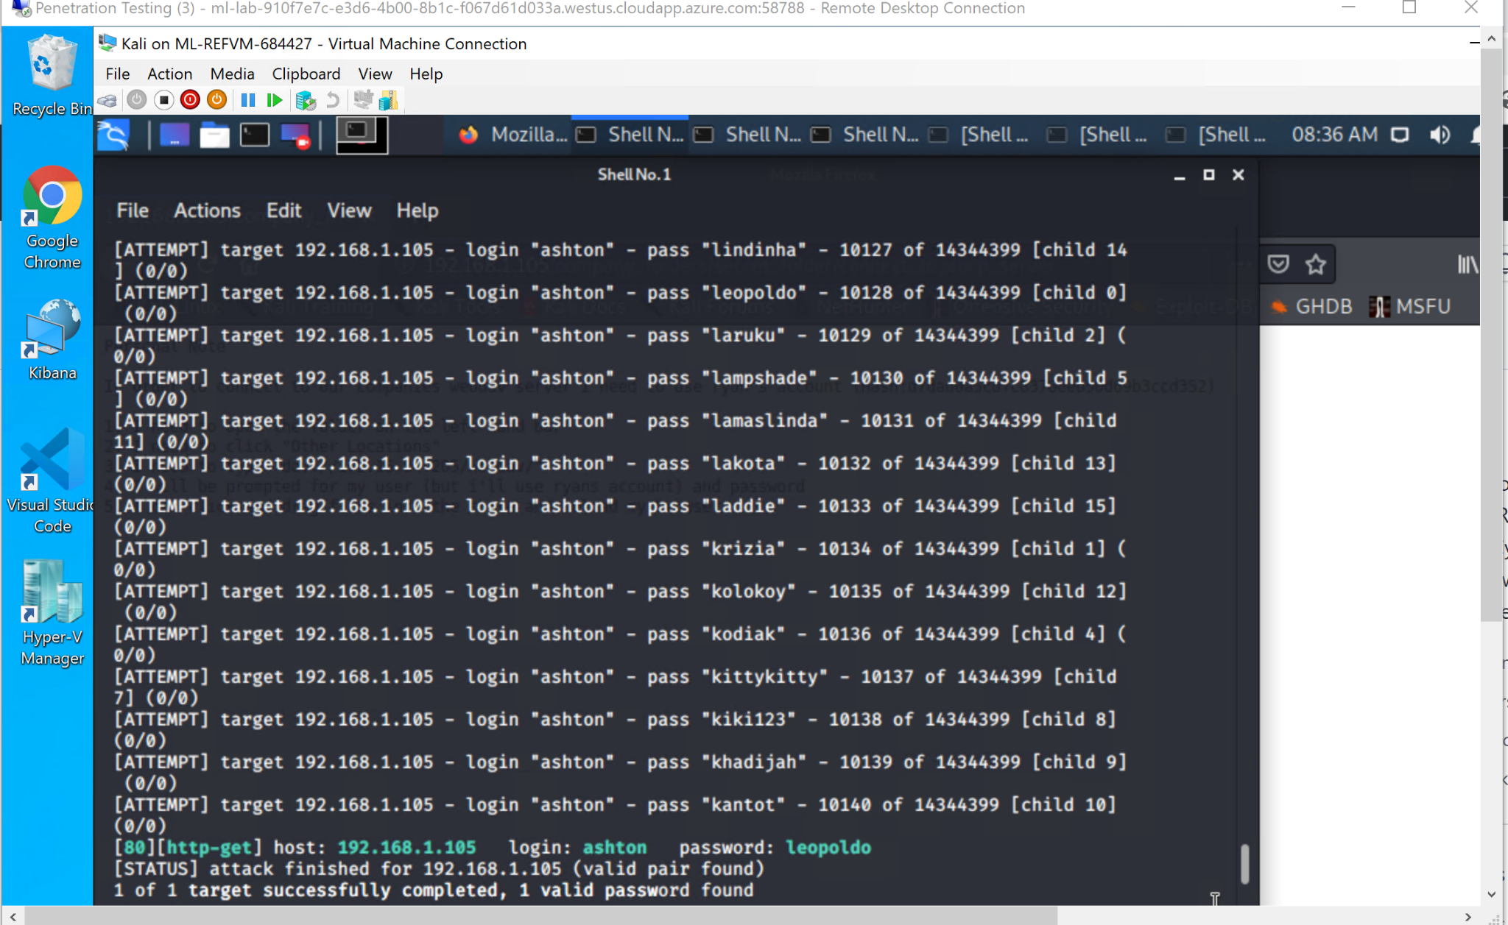
Exploitation: [BRUTE FORCE Vulnerability]
01
02
03
Tools & Processes
Hydra , a password cracking tool was used to brute force the password of the hidden directory.
Achievements
I successfully cracked the password for the hidden directory : 192.168.1.105/company_folders/secret_folder
The username found was : ashton and the password was: leopoldo

Slide 10
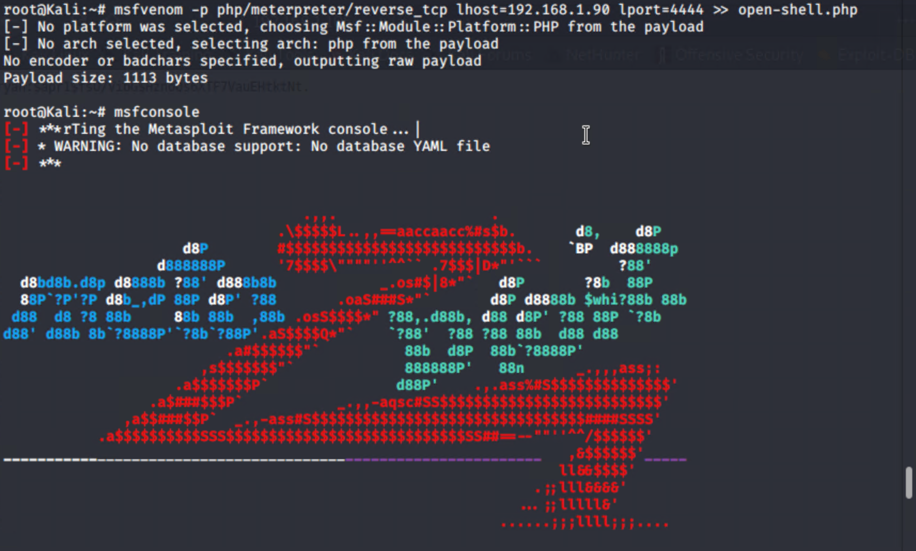
Exploitation: [BACKDOOR VULNERABILITY]
01
02
03
Tools & Processes
Msfvenom was used to set up a reverse shell.
Achievements
This tool was used to successfully set up a reverse shell and set up a listener on the victim machine

Slide 11

Blue Team
Log Analysis and Attack Characterization
‹#›

Slide 12
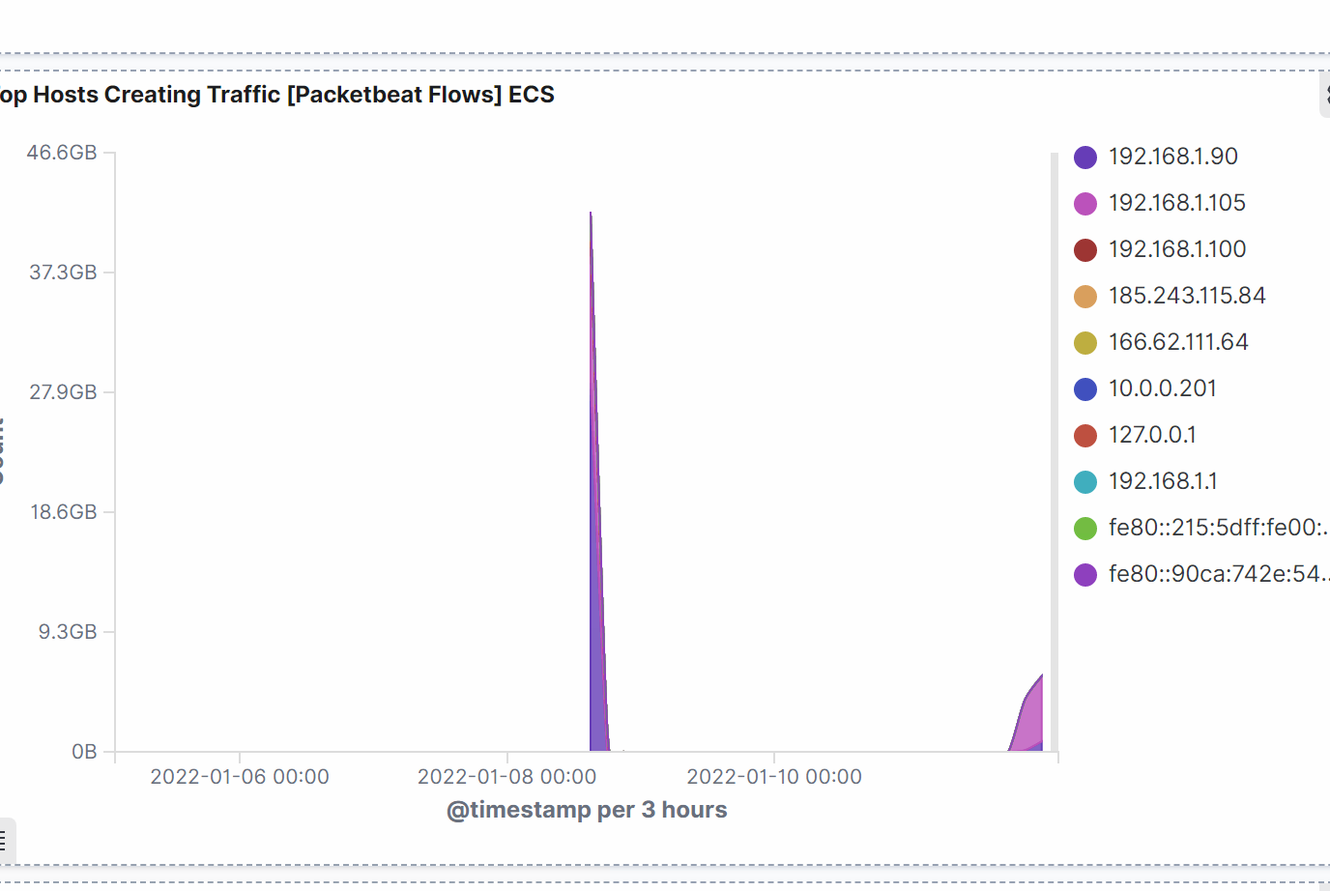
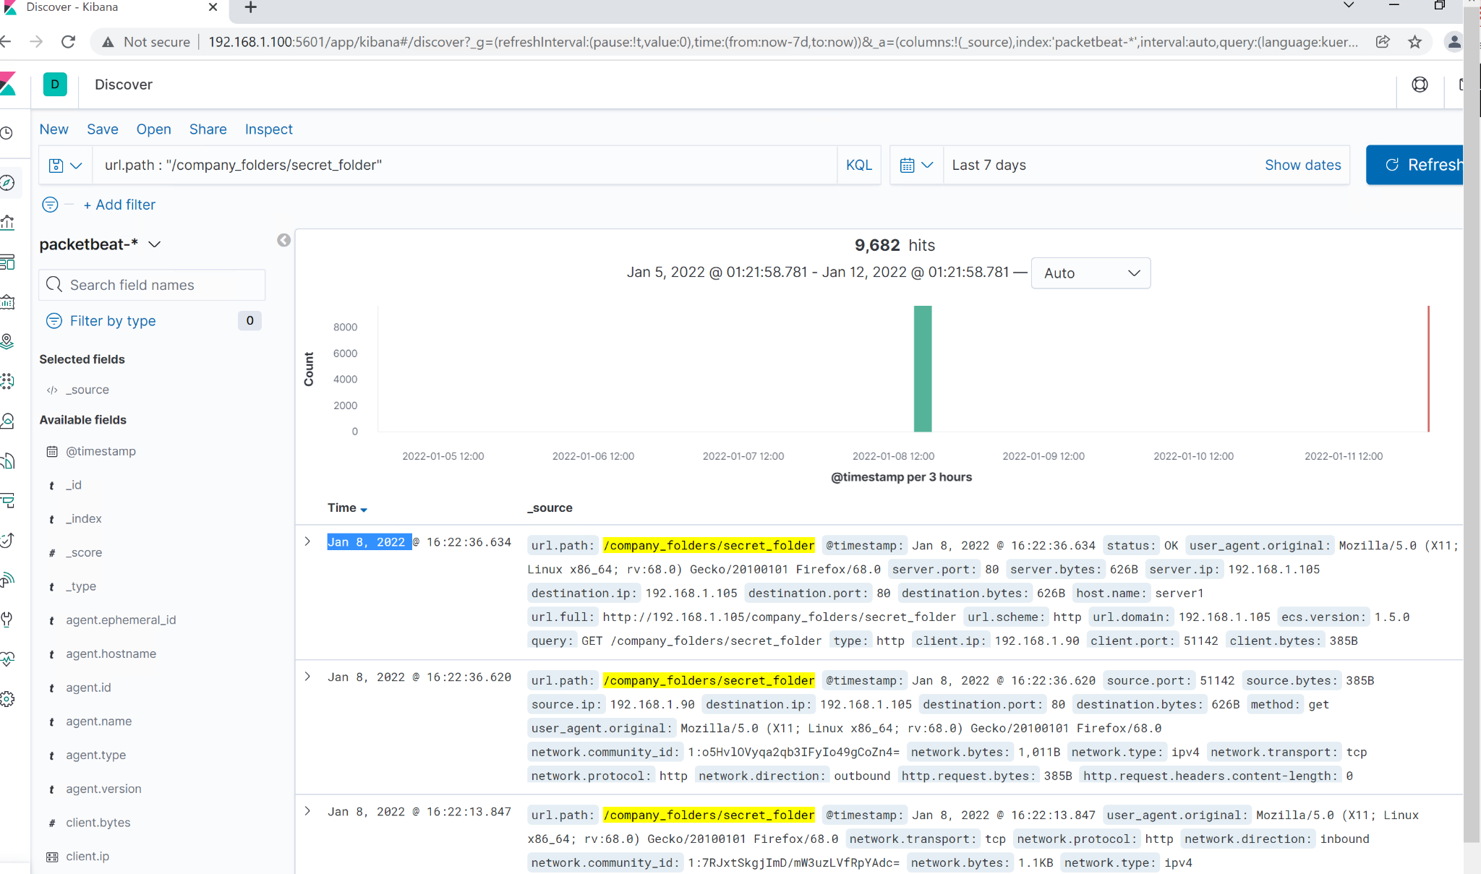

Analysis: Identifying the Port Scan
The port scan occurred on January 8,2022 at 4pm
The total number of packets are 9,682 from 192.168.1.90

Slide 13
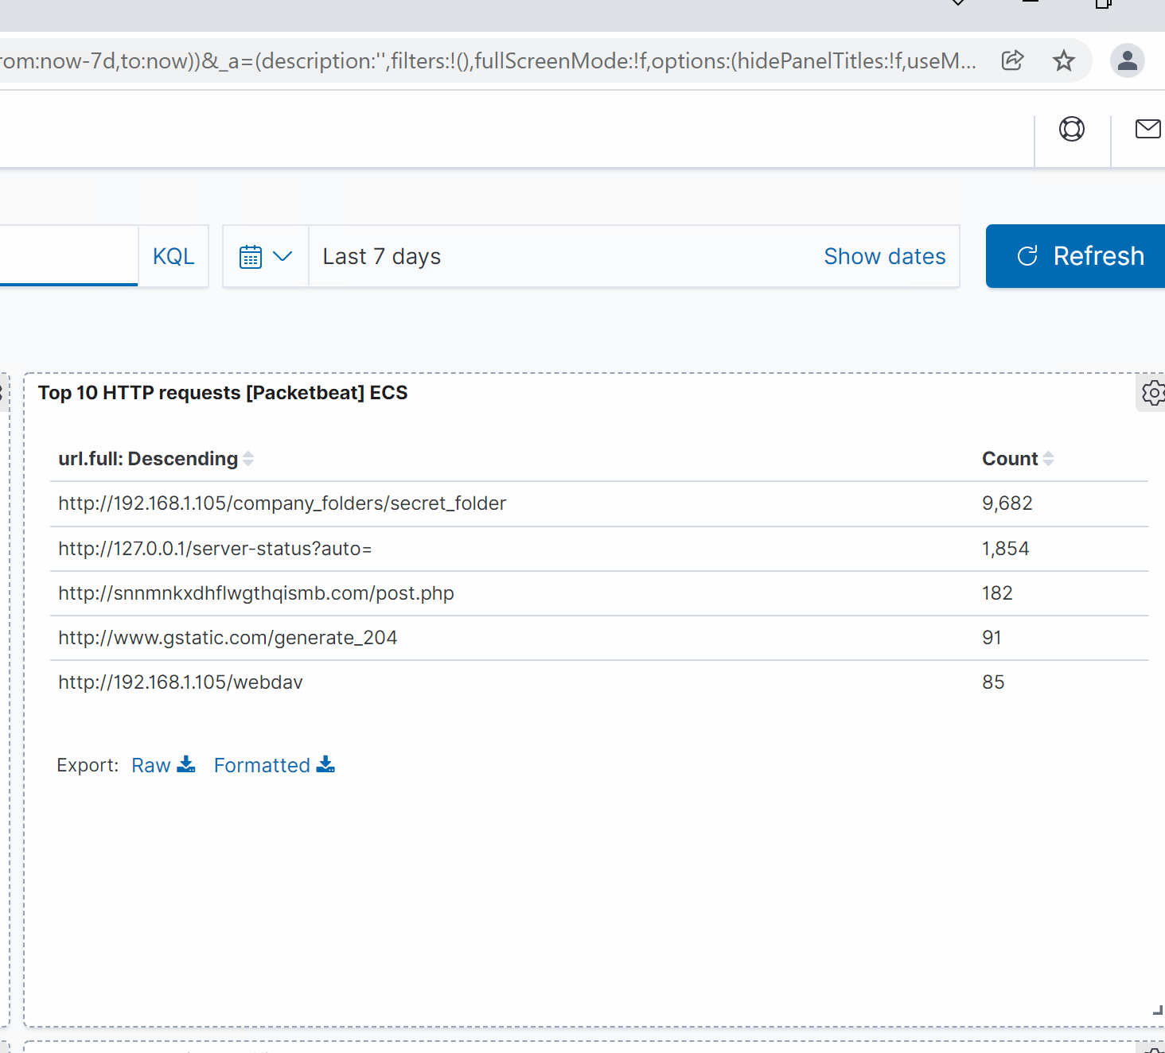
Analysis: Finding the Request for the Hidden Directory
The hidden directory was requested on January 28,2022 at 4:22pm and it was requested 9,682 times
The secret folder contained a file called : connect_to_corp_server

Slide 14
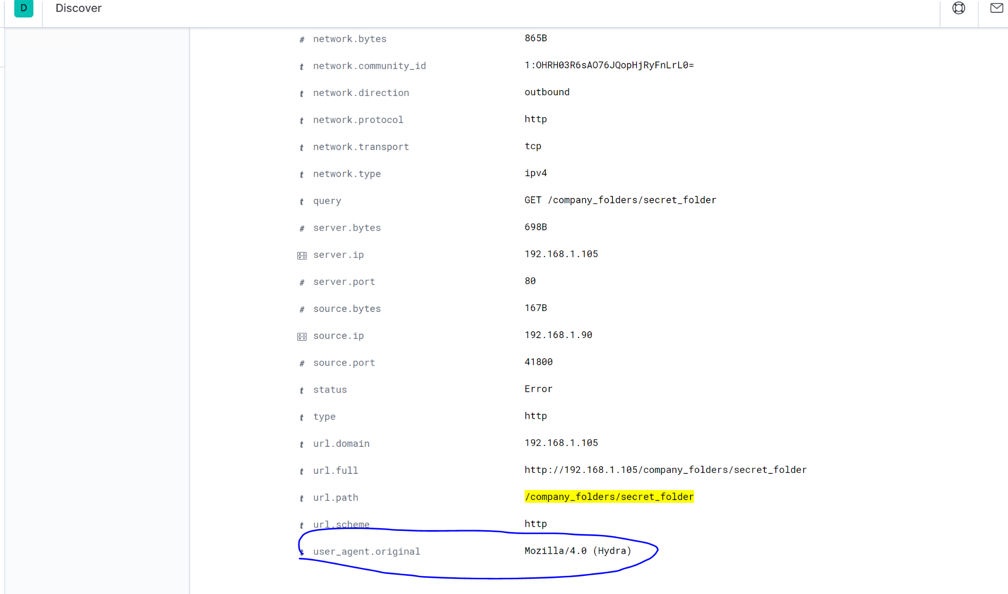
Analysis: Uncovering the Brute Force Attack
The brute force attack was done using Hydra
The total number of request that were made to this folder was 9

Slide 15
Analysis: Finding the WebDAV Connection
The directory was requested 85 times
The files requested were the password.dav and the shell.php files

Slide 16
Blue Team
Proposed Alarms and Mitigation Strategies
‹#›

Slide 17
Mitigation: Blocking the Port Scan
What kind of alarm can be set to detect future port scans?
An alert can be set to trigger when there are so many requests targeting multiple ports from a single IP address.
What threshold would you set to activate this alarm?
The alarm would be activated if there are more than 10 requests in a second for 1 minute continuously
What configurations can be set on the host to mitigate port scans?
We can set up a firewall to only allow specific IP addresses to conduct port scans. We can also ran scans to determine whether more ports are open than required.

Slide 18
Mitigation: Finding the Request for the Hidden Directory
What kind of alarm can be set to detect future unauthorized access?
An alarm can be set to trigger anytime the hidden directory is accessed outside the company’s internal network.
What threshold would you set to activate this alarm?
The alarm should be activated for 1 or more requests.
What configuration can be set on the host to block unwanted access?
This hidden directory should be removed from the server totally.
Describe the solution. If possible, provide required command lines.
The directory, if left on the server can be accessed by a hacker and will no longer be a hidden directory. Such sensitive company information should not be on the server at all.

Slide 19
Mitigation: Preventing Brute Force Attacks
What kind of alarm can be set to detect future brute force attacks?
An alarm can be set to be triggered when there’s a 401 error code return from any server over a certain threshold. Also, the alarm can be set to be triggered if the user agent includes the word “Hydra”
What threshold would you set to activate this alarm?
The alert will be triggered anytime (one or more) the useragent includes Hydra. The alert can also be triggered if the 401 error code return is more than 15 per minute.
What configuration can be set on the host to block brute force attacks?
We can set up a lockout policy to lock out all users that are unable to sign in for more than 3 times and can only be unlocked by an admin after providing a unique id number. Also, a firewall can be setup to immediately block any traffic that includes the word Hydra once the alarm is triggered.
Describe the solution.
If accounts get locked after three tries and can can only be unlocked by admins, attackers can hardly brute force

Slide 20
Mitigation: Detecting the WebDAV Connection
What kind of alarm can be set to detect future access to this directory?
An alarm can be set to trigger anytime this directory is accessed outside the company’s internal network or accessed by unauthorised users.
What threshold would you set to activate this alarm?
The alarm should be activated for 1 or more requests that are made to this directory
What configuration can be set on the host to control access?
Connections to this directory should not be accessible from the web and only specific IP addresses should be allowed to access the directory.
Describe the solution. If possible, provide the required command line(s).
If connections to this directory are restricted and not accessible on the web, it will be very hard for an attacker to get access to it.

Slide 21
Mitigation: Identifying Reverse Shell Uploads
What kind of alarm can be set to detect future file uploads?
An alert can be set to trigger once a .php file is uploaded to the server and also an alarm to trigger for any traffic that moves over port 4444.
What threshold would you set to activate this alarm?
The threshold would be one or more. Any instance where there is traffic over the port 4444 or a .php file is uploaded should trigger an alarm
What configuration can be set on the host to block file uploads?
Removing the ability to upload files to this directory over the web.
Describe the solution. If possible, provide the required command line.
If the ability to to upload files over the web is totally removed, no potentially harmful files will be uploaded.

